Slide 1
SWARNANDHRA COLLEGE OF ENGINEERING ANDTECHNOLOGY
DEPARTMENT OF COMPUTER SCIENCE AND ENEGINEERING
Title of the Project
OPTIMAL DRUG DOSAGE CONTROL STRATEGY OF IMMUNE SYSTEM USING REINFORCEMENT LEARNING
Team Members:
Sana. Mounika (20A21A05F8)
Shakamuri. Madhuri Vijaya Lakshmi(20A21A05G1)
Yarramsetty. Ramyasri (20A21A05J0)
Undapalli. Hasini (20A21A05H5)
Project Coordinator
Mr.K.Rajesh Kumar M.Tech,Ph.D
Associate Prof.
Under The Guidance Of
Dr.B.Rama Krishna M.Tech,Ph.D
Associate prof.

Slide 2
Abstract
Introduction
Existing System
Output Screen Shots
Proposed System
System Requirements Specification
Modules
Algorithms
UML diagrams
Datasets
Architecture
Conclusion
Future Enhancement
References
CONTENTS

Slide 3
ABSTRACT
a reinforcement learning-based drug dosage control strategy is developed for immune systems with input constraints and dynamic uncertainties to sustain the number of tumor and immune cells in an acceptable level. First of all, the state of the immune system and the desired number of tumor and immune cells are constructed into an augmented state to derive an augmented immune system. By designing a discounted non-quadratic performance index function, the robust tracking control problem of immune systems with uncertainties is transformed into an optimal tracking control problem of nominal immune systems and the drug dosage can be limited within the specified range.Furthermore, theoretical proof reveals that the proposed reinforcement learning-based drug dosage control strategy ensures the number of tumor and immune cells reaches the preset level under limited drug dosages and model uncertainties. Finally, simulation study verifies the availability of the developed drug dosage control strategy in different growth models of tumor cell.

Slide 4
INTRODUCTION
Human immune system plays a crucial role in defending the body against various pathogens and maintaining overall health.
However maintaining an optimal balance in immune response is a complex task especially in the context of treating diseases or disorders. Traditional drug dosage strategies often lack precision and may lead to suboptimal outcomes.
Reinforcement learning ( RL), a branch of artificial intelligence, offers a promising approach for optimizing drug dosage control in the immune system. RL algorithms learn from interactions with the environment and make decisions that maximize a defined objective over time.
Applying RL to immune system modulation provides an adaptive and personalized approach to drug dosage. The fog-driven IoT healthcare system consists of the three following layers: healthcare device layer, medical fog layer, and medical cloud layer.

Slide 5
EXISTING SYSTEM
For the trajectory tracking control problem, Modares et al. designed a data-based integral RL algorithm to address the linear quadratic trajectory tracking control problem. The risk factors of tumorigenesis are highly diverse, including genetic alterations, poor diet, physical
inactivity, chronic infections and so on.
Later, an off-policy integral RL algorithm was proposed to cope with the optimal exponential tracking control of unknown linear systems.
Wei et al. [36] investigated event-triggered near-optimal tracking control of boiler-turbine systems with asymmetric input constraints. In continuous-time systems, Yang et al. [37] addressed the event-triggered constrained robust control problem for nonlinear systems with mismatched uncertainties via single network adaptive critic design.

Slide 6
PROPOSED SYSTEM
Compared with existing approaches, which developed robust control schemes for uncertain immune systems to maintain the number of immune cells and tumor cells at a appropriate level only, this paper further considers the drug dosage optimization problem. By employing RL technique, the drug dosage is reduced as much as possible while ensuring the treatment effect. Therefore, it is salutary to human body.
Unlike existing immune optimization regulation approaches,that considered idea model only, this paper considers model uncertainties and input constraints simultaneously, which is more appropriate in actual scenario. By designing a discounted non-quadratic performance index function, the developed RL-based drug dosage control strategy guarantees the number of immune cells and tumor cells maintain at the desired level under model uncertainties and limited drug dosages

Slide 7
ADVANTAGES
ADAPTABILITY: Reinforcement learning enables dynamic adaptation to changes in the patient's immune
response, allowing for personalized and responsive dosage adjustments.
POTENTIAL FOR COMPLEX REGIMENS: RL algorithms can handle complex drug regimens involving
Multiple agents or dosages, optimizing combinations for enhanced therapeutic effects.
REAL-TIME DECISION MAKING:The algorithm can provide real-time recommendations, facilitating timely adjustments in response to changing patient conditions.
RESOURCE OPTIMIZATION : Efficient drug dosing can lead to better resource allocation in healthcare
settings by minimizing unnecessary treatments and hospital

Slide 8
SYSTEM REQUIREMENT SPECIFICATION
Software Requirements:
Operating System
-
-
-
-
Windows 10 Java/J2EE(JSP , Servlet) HTML, CSS, Javascript MySQL
Coding Language
Front End
Back End
Hardware System Configuration:-
Processor
RAM
Hard Disk
-
-
-
Intel i5
8 GB
1 TB

Slide 9
MODULE IMPLEMENTATION
Admin: In this module, the Service Provider has to login by using valid user name and password. After login successful he can do some operations such as view All Users,View All Datasets,View All Datasets by Group of Dosage Control,View All Dosage Control Activity Results,View All Medical Condition Results.
View and Authorize Users: In this module, the admin can view the list of users who all registered. In this, the admin can view the user’s details such as, user name, email, address and admin authorizes the users.
Remote User: In this module, there are n numbers of users are present. User should register before doing any operations. Once user registers, their details will be stored to the database. After registration successful, he has to login by using authorized user name and password . Once Login is successful user will do some operations like Register and Login,View My Profile , Upload Datasets , Find Dosage Control Results , Search Medical Condition.

Slide 10
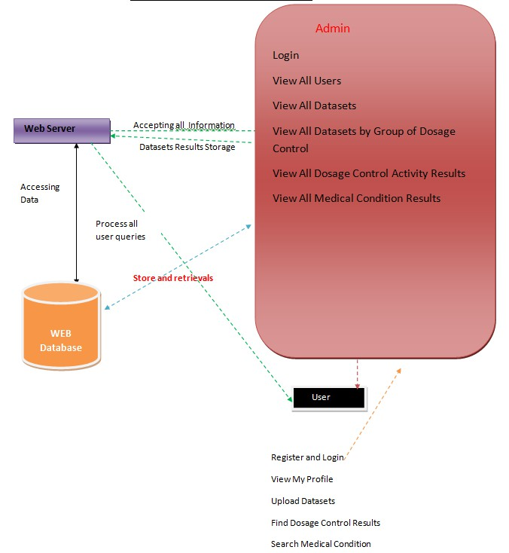
ARCHITECTURE DIAGRAM

Slide 11
ALGORITHMS
MODEL DYNAMICS:
Develop a model describing how the immune system responds to different drug dosages over time. This model is crucial for the reinforcement learning algorithm.
REINFORCEMENT LEARNING ALGORITHM:
Choose an appropriate RL algorithm(e. g., Q- learning, Deep Q Networks) to learn optimal drug dosage policies.
SAFETY MEASURES:
Implement safety constraints to prevent the algorithm from suggesting dosages that may cause harm.

Slide 12
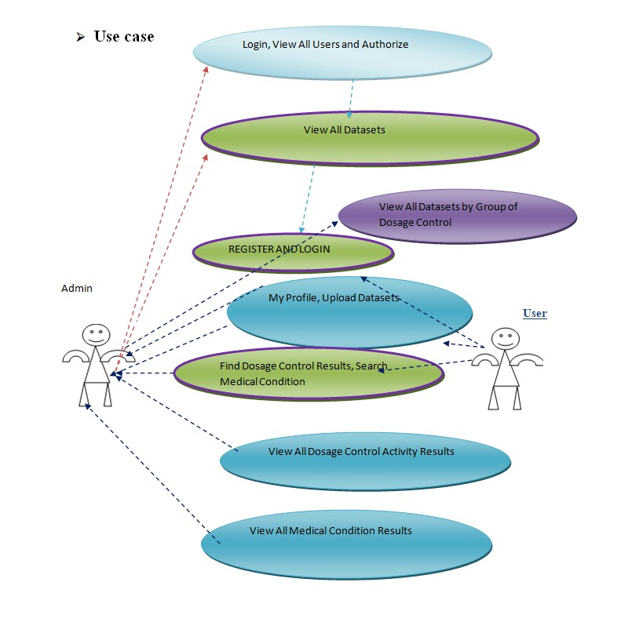
UML DIAGRAMS

Slide 13
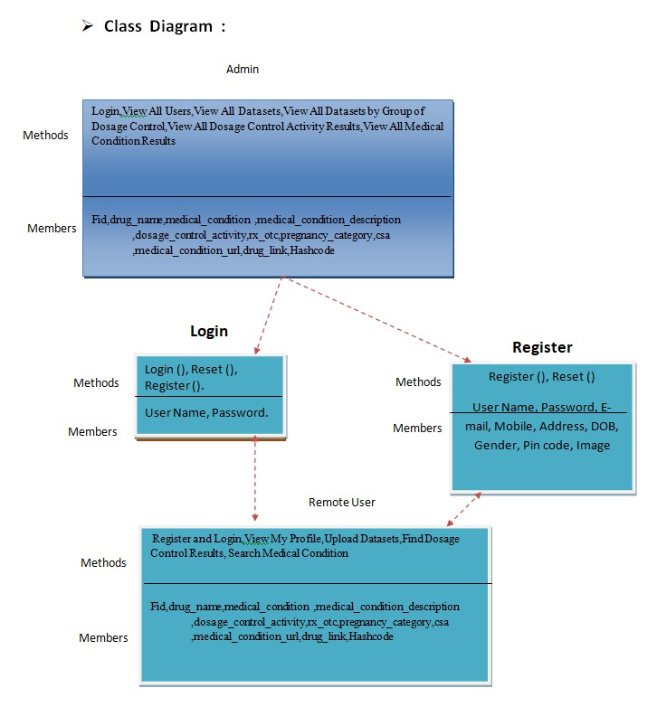

Slide 14
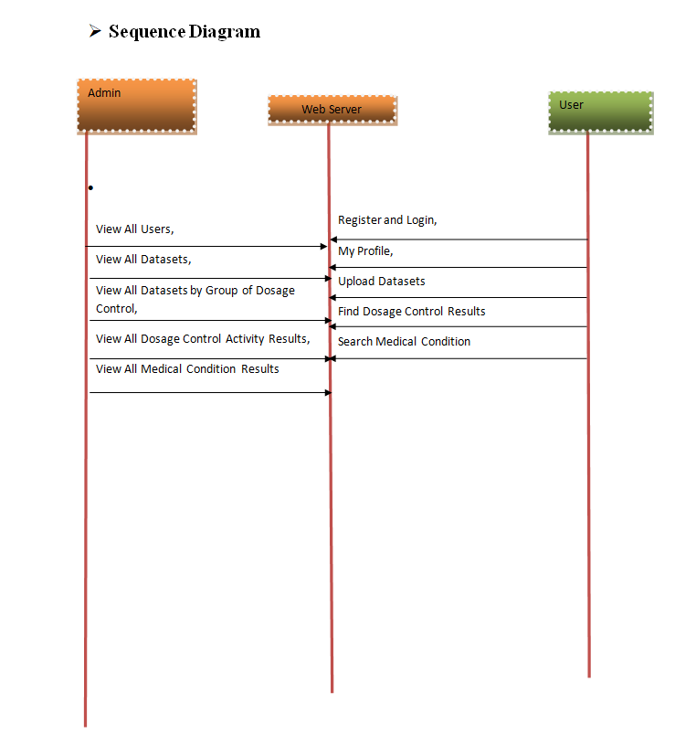

Slide 15
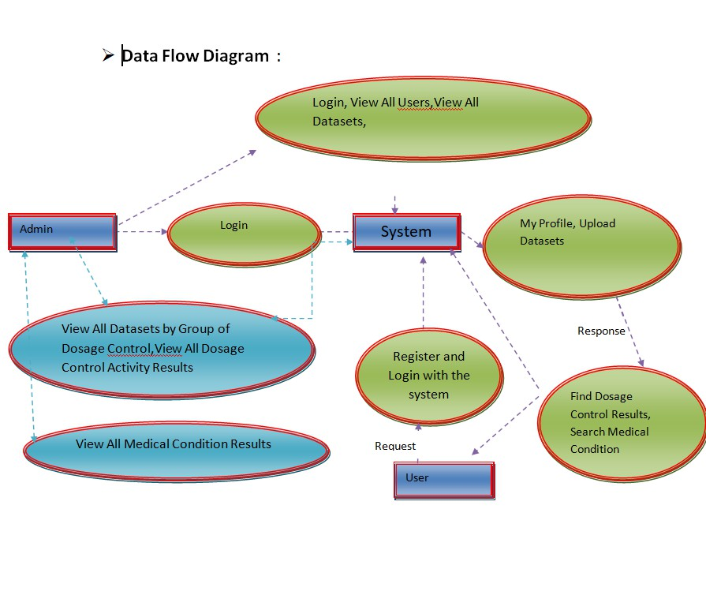

Slide 16
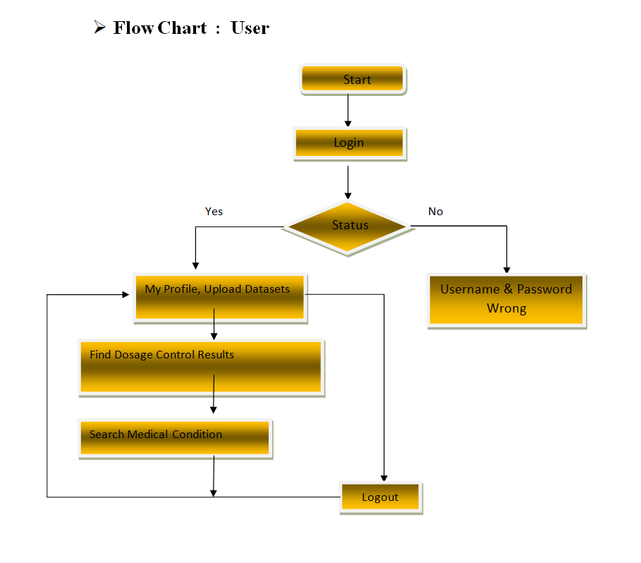

Slide 17
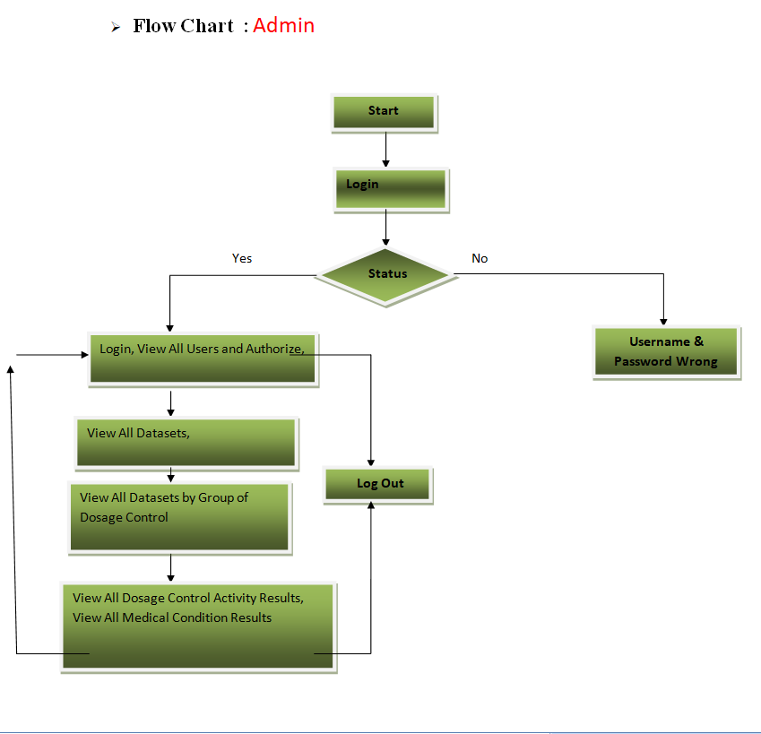

Slide 18
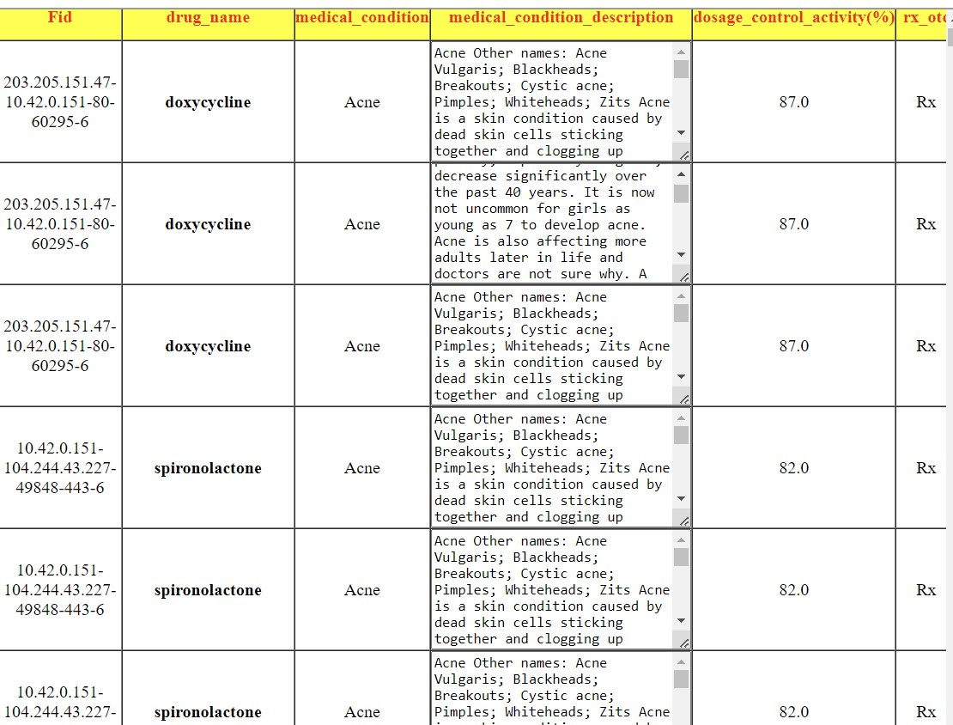
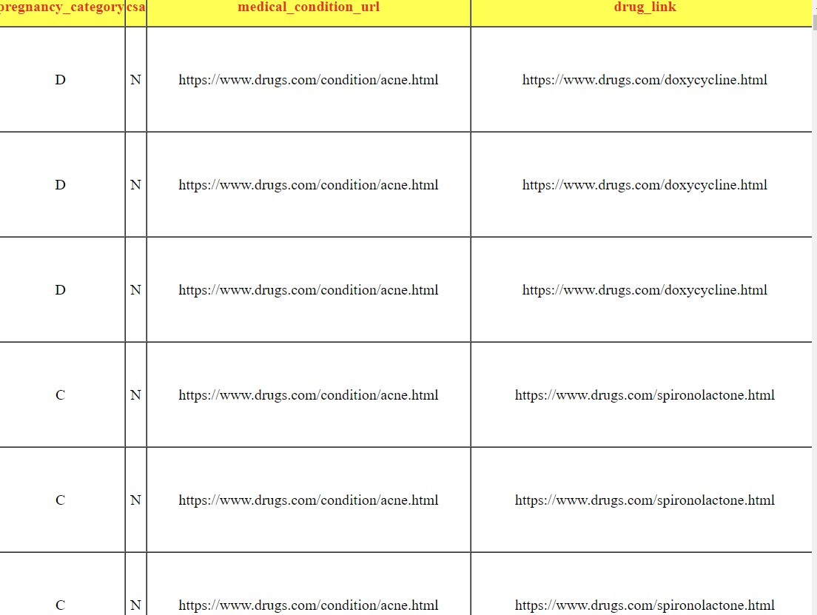
DATASETS

Slide 19
OUTPUT SCREENSHOTS

Slide 20
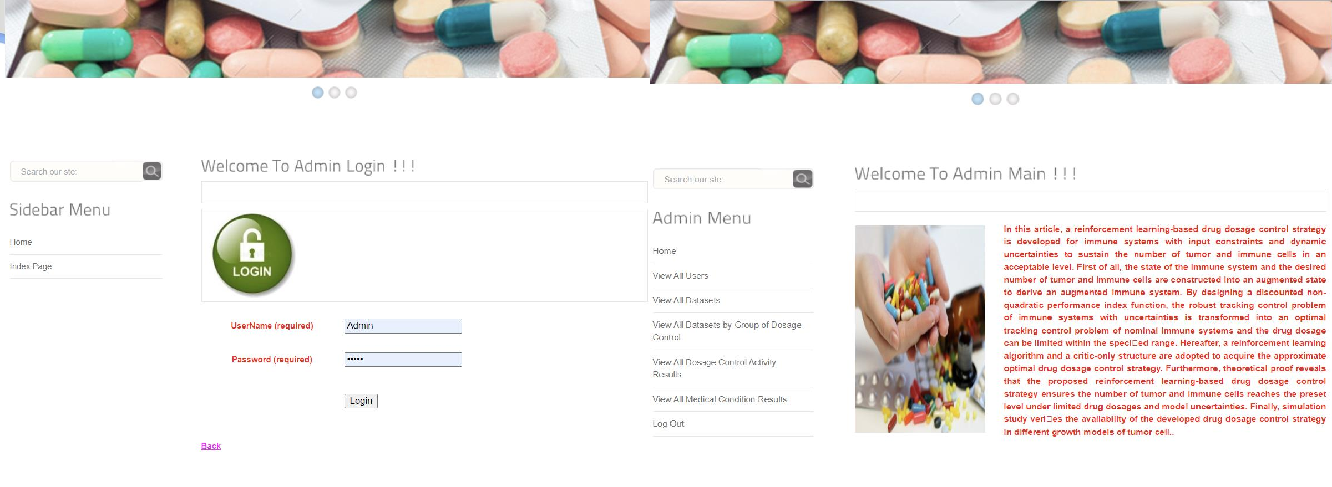

Slide 23
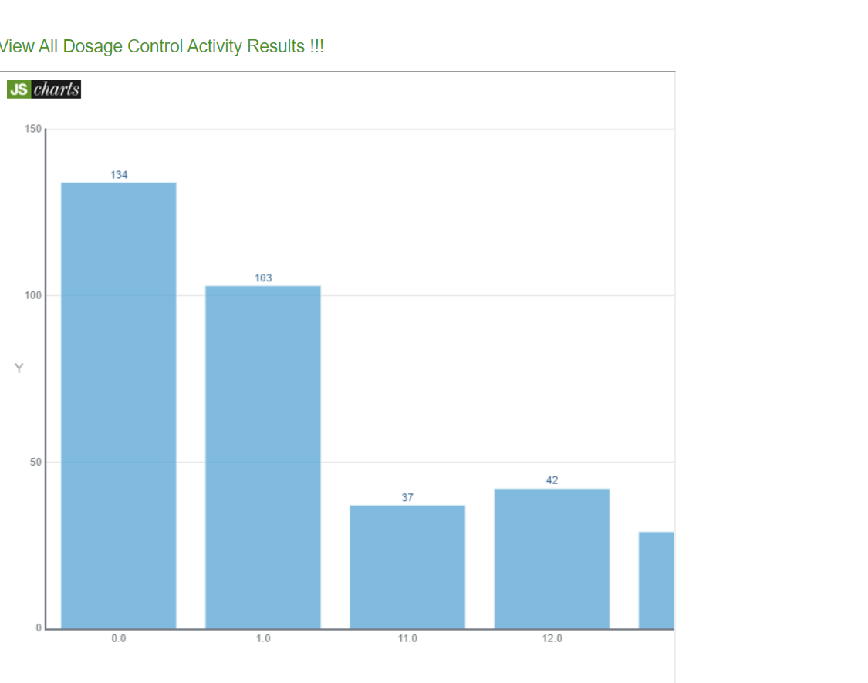
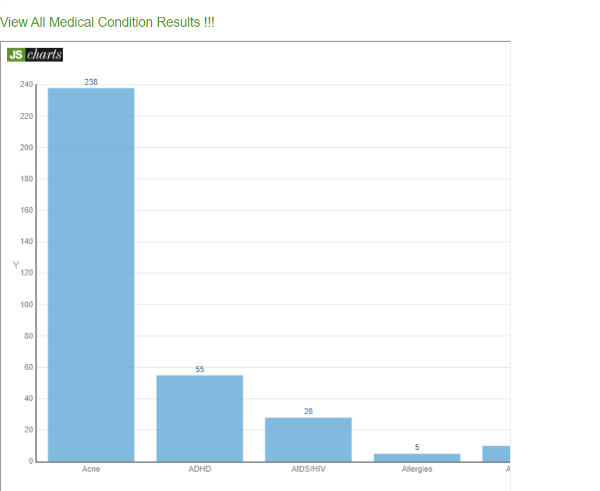

Slide 24
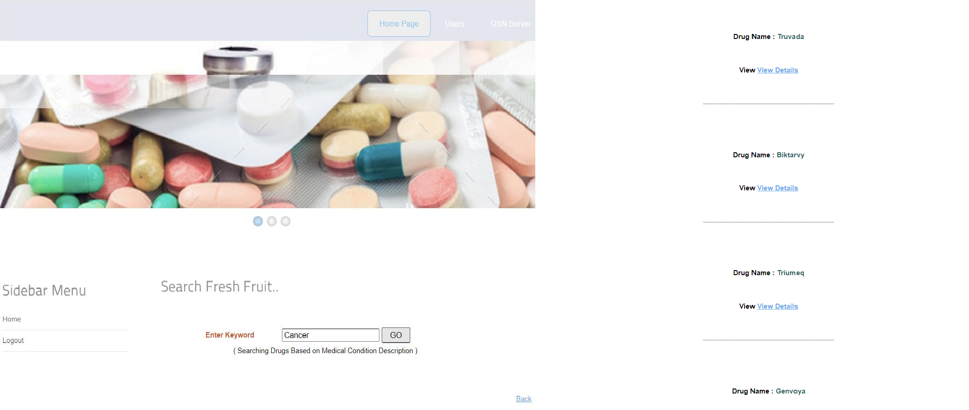

Slide 26
CONCLUSION
This paper provides an immunotherapy regimen for cancer via RL technique. We show that it can be obtained by addressing the robust tracking control problem of immune systems subject to input constraints and dynamic uncertainties in control community.
To accomplish this goal, an augmented immune system and a discounted non-quadratic performance index function are established such that the robust tracking control problem of uncertain immune systems is converted to an optimal tracking control problem of its nominal plant.
Subsequently, we develop constrained drug dosage control strategy by using RL algorithm and criticonly structure.
According to the Lyapunov theory, we proof that the developed RL-based drug dosage control strategy ensures the number of tumor and immune cells reaches to the preset level with limited drug dosages.
At last, simulation results display that the developed immunotherapy regimen is feasible.

Slide 27
FUTURE ENHANCEMENT
By addressing these areas, future enhancements in RL-based drug dosage control strategies for the immune system could significantly improve treatment efficacy, patient safety, and healthcare outcomes.
Personalized Medicine
Adaptive Learning
Multi-Agent Systems
Safety and Robustness
Exploration - Exploitation

Slide 28
REFERENCES
[1] H. Sung, J. Ferlay, R. L. Siegel, M. Laversanne, I. Soerjomataram A. Jemal, and F. Bray, ``Global cancer statistics 2020: GLOBOCAN estimates of incidence and mortality worldwide for 36 cancers in 185
countries,'' CA, Cancer J. Clinicians, vol. 71, no. 3, pp. 209_249, May 2021.
[2] D. Hanahan, ``Hallmarks of cancer: New dimensions,'' Cancer Discovery, vol. 12, no. 1, pp. 31_46, Jan. 2022.
[3] D. Hanahan and R.Weinberg, ``Hallmarks of cancer: The next generation,'' Cell, vol. 144, no. 5, pp. 646_774, Mar. 2011.
[4] F. Greene and L. Sobin, ``The staging of cancer: A retrospective and prospective appraisal,'' CA, Cancer J. Clinicians, vol. 58, no. 3,pp. 180_190, May 2008.
[5] R. Nowarski, N. Gagliani, S. Huber, and R. A. Flavell, ``Innate immune cells in in_ammation and cancer,'' Cancer Immunol. Res., vol. 1, no. 2,pp. 77_84, Aug. 2013.
[6] S. Woo, L. Corrales, and T. Gajewski, ``Innate immune recognition of cancer,'' Annu. Rev. Immunol., vol. 33, pp. 445_474,Jan. 2015.

Slide 29
THANK YOU

